Slide 1
Dynamic Characteristics of Measurement Systems
Sensors and Actuators – Joel von Rotz

Slide 2
Required Content
Transfer Function G(s)
First order element
Second order element
Identification of the dynamics of an element
Step response
Sinusoidal response
Dynamic errors in measurement systems
Techniques for dynamic compensation

Slide 3
Overview
Transfer Function G(s)
Identification of the dynamics of an element
Dynamic errors in measurement systems
Techniques for dynamic compensation

Slide 4
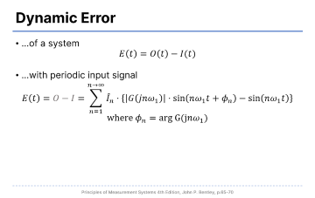
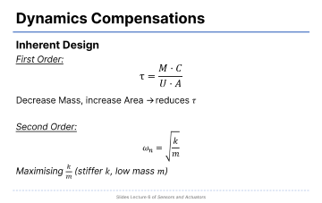
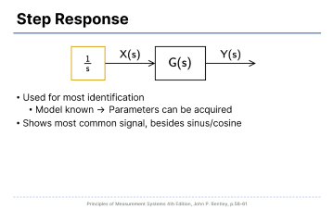
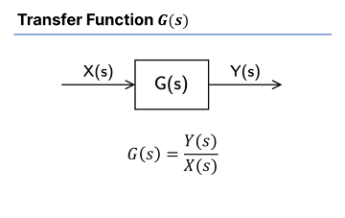
Overview

Slide 5
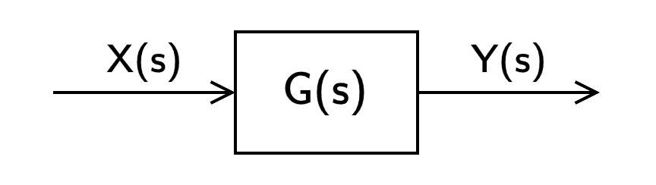

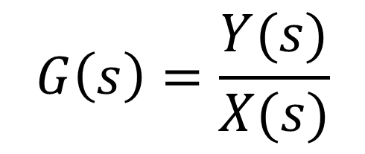
Transfer Function $G(s)$
$$G\left(s\right)=\frac{Y(s)}{X(s)}$$
Notes:
Where:
M = detector mass ($kg$)
C = detector specific heat ($J kg^{−1} °C^{−1}$)
A = detector surface area ($m^{2}$)
U = heat transfer coefficient ($W m^{−2} °C^{−1}$)

Slide 6
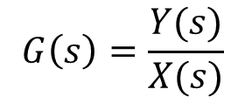
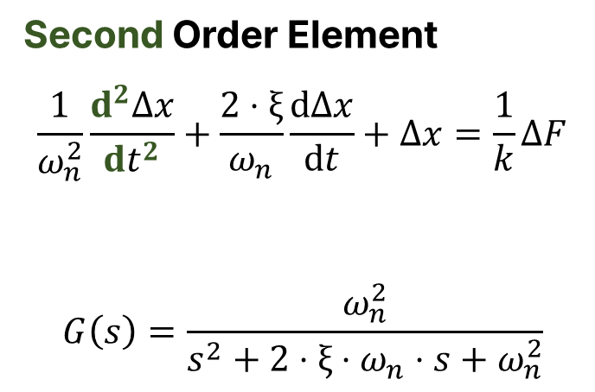
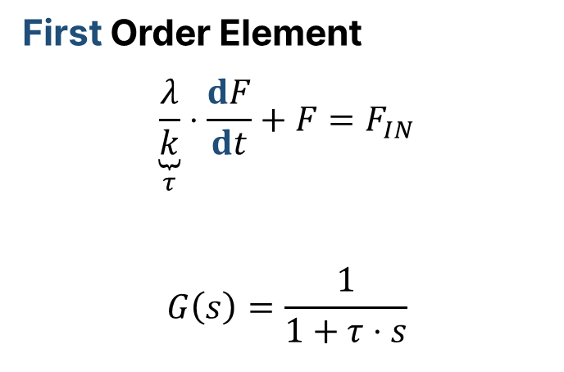
Transfer Function $G(s)$
$$G\left(s\right)=\frac{Y(s)}{X(s)}$$
First Order Element
$$\underset{τ}{\underbrace{\frac{λ}{k}}}⋅\frac{dF}{dt}+F=F_{IN}$$
$$G\left(s\right)=\frac{1}{1+τ⋅s}$$
Second Order Element
$$\frac{1}{ω_{n}^{2}}\frac{d^{2}Δx}{dt^{2}}+\frac{2⋅ξ}{ω_{n}}\frac{dΔx}{dt}+Δx=\frac{1}{k}ΔF$$
$$G\left(s\right)=\frac{ω_{n}^{2}}{s^{2}+2⋅ξ⋅ω_{n}⋅s+ω_{n}^{2}}$$
Notes:
$$τ=\frac{R}{L}=RC=\frac{MC}{UA}$$
Where:
M = detector mass ($kg$)
C = detector specific heat ($J kg^{−1} °C^{−1}$)
A = detector surface area ($m^{2}$)
U = heat transfer coefficient ($W m^{−2} °C^{−1}$)

Slide 7
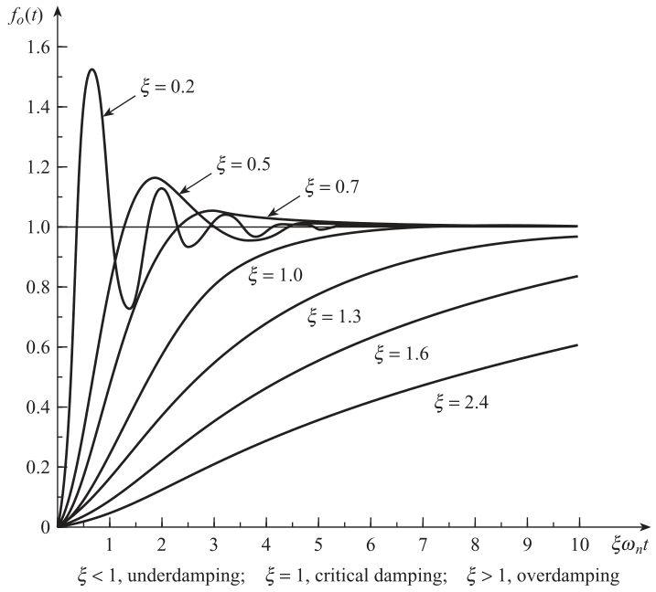
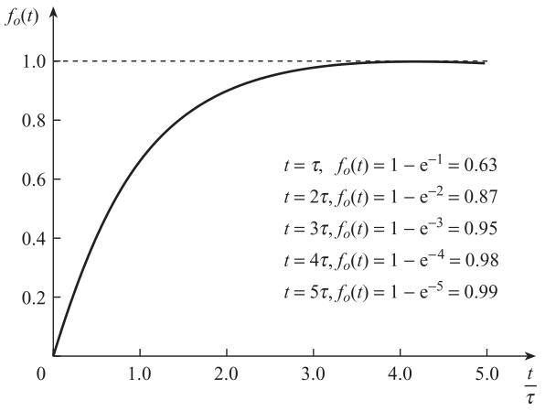
Transfer Function $G(s)$
Notes:
Left first order, right second order
For oscillation to occure, TWO energy sources are required!

Slide 8


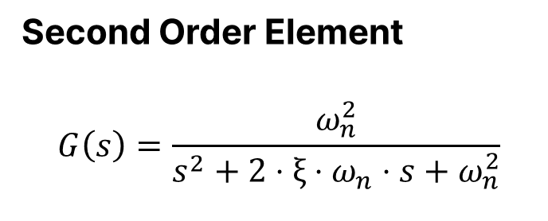
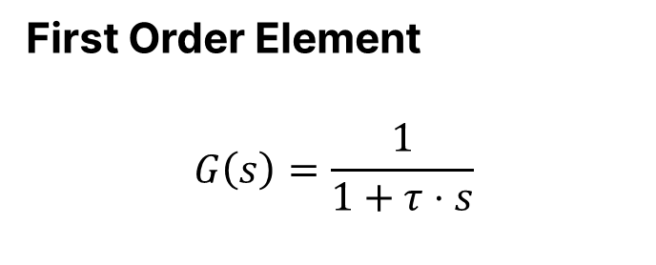
Transfer Function $G(s)$
First Order Element
$$G\left(s\right)=\frac{1}{1+τ⋅s}$$
Second Order Element
$$G\left(s\right)=\frac{ω_{n}^{2}}{s^{2}+2⋅ξ⋅ω_{n}⋅s+ω_{n}^{2}}$$
$$τ_{Th}=\frac{M⋅C}{U⋅A}=R_{Th}⋅C_{Th}$$
$$τ_{Th}=\frac{M⋅C}{U⋅A}=R_{Th}⋅C_{Th}$$
Notes:
Where:
M = detector mass ($kg$)
C = detector specific heat ($J kg^{−1} °C^{−1}$)
A = detector surface area ($m^{2}$)
U = heat transfer coefficient ($W m^{−2} °C^{−1}$)

Slide 9
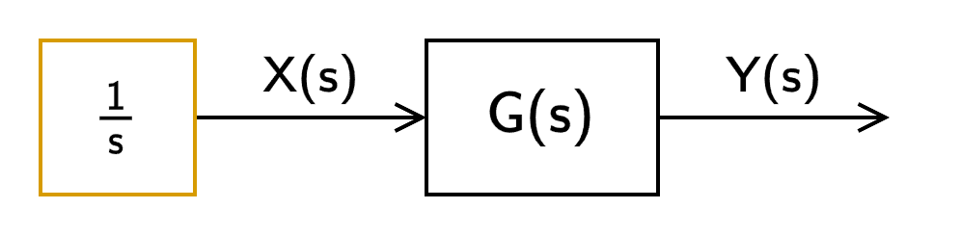
Step Response
Used for most identification
Model known → Parameters can be acquired
Shows most common signal, besides sinus/cosine

Slide 10

Step Response
Error
$$f_{0}\left(t\right)=1−\exp\left(−\frac{t}{τ}\right)$$
Notes:
Left first order, right second order
For oscillation to occure, TWO energy sources are required!

Slide 11
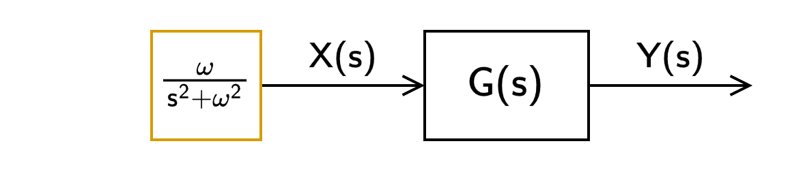
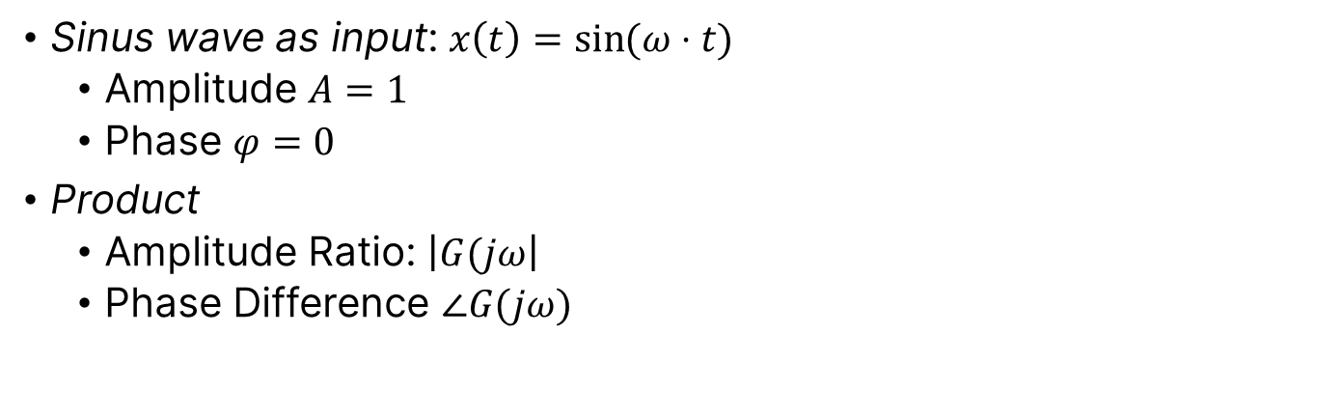
Sinusoidal Response
Sinus wave as input: $x\left(t\right)=\sin{(ω⋅t)}$
Amplitude $A=1$
Phase $φ=0$
Product
Amplitude Ratio: $\left|G(jω\right|$
Phase Difference $∠G(jω)$

Slide 12
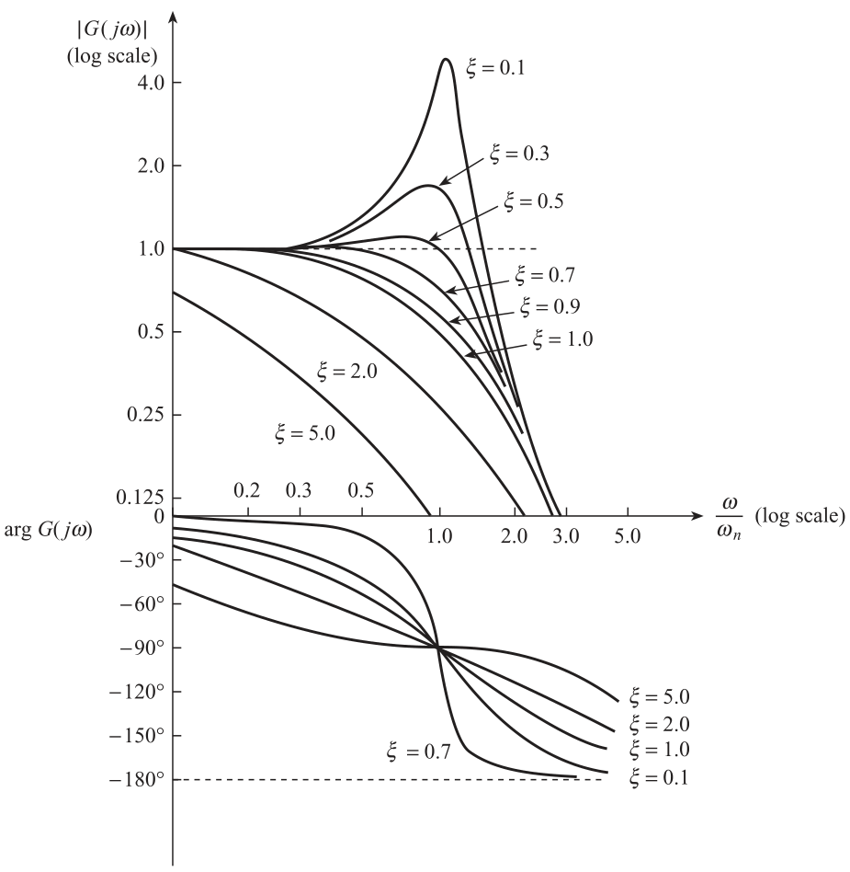
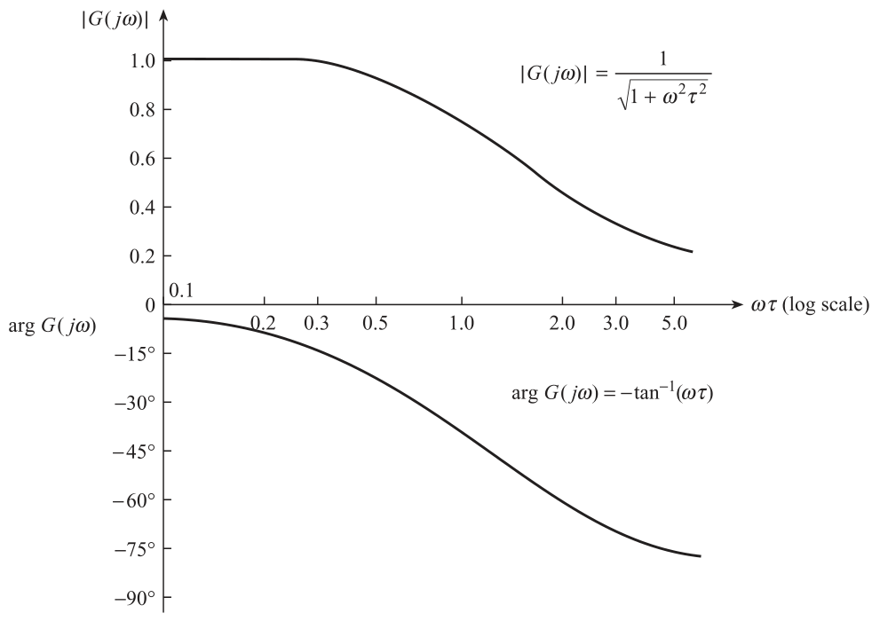
Sinusoidal Response
Second Order →
First Order ↓

Slide 13
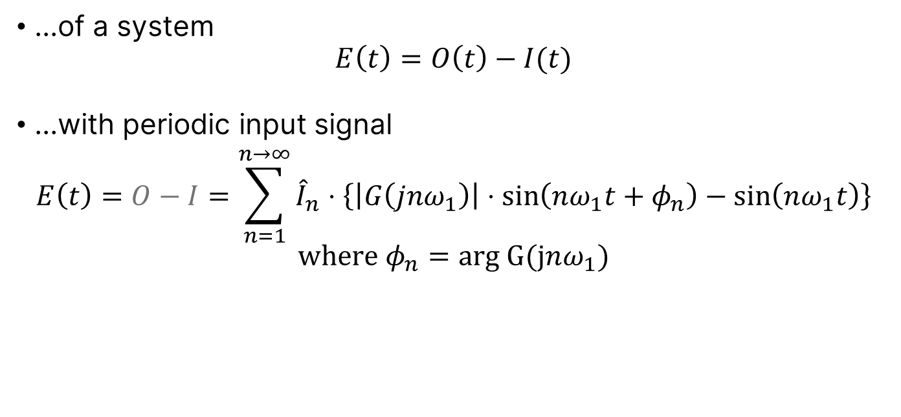
Dynamic Error
...of a system
$$E\left(t\right)=O\left(t\right)−I(t)$$
...with periodic input signal
$$E\left(t\right)=O−I=\sum_{n=1}^{n→∞}{{\hat{I}}_{n}⋅\left\{\left|G\left(jnω_{1}\right)\right|⋅\sin\left(nω_{1}t+φ_{n}\right)−\sin\left(nω_{1}t\right)\right\}}$$
$$\text{where} φ_{n}=arg G(jnω_{1})$$

Slide 14
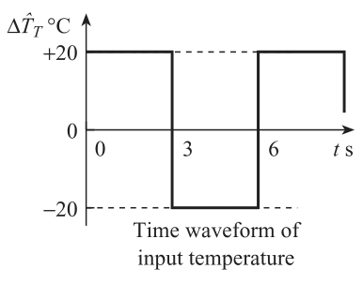
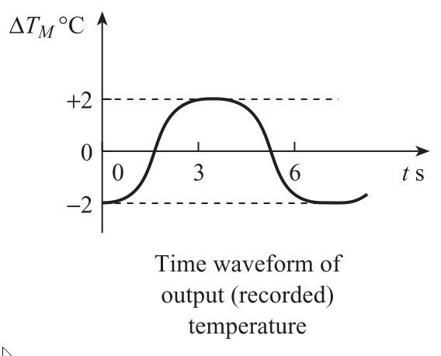

Dynamic Error
Fourier series for periodic signals
$$f\left(t\right)=a_{0}+\sum_{n=1}^{n→∞}{a_{n}+\cos\left(nω_{1}t\right)}+\sum_{n=1}^{n→∞}{b_{n}+\sin\left(nω_{1}t\right)}$$

Slide 15
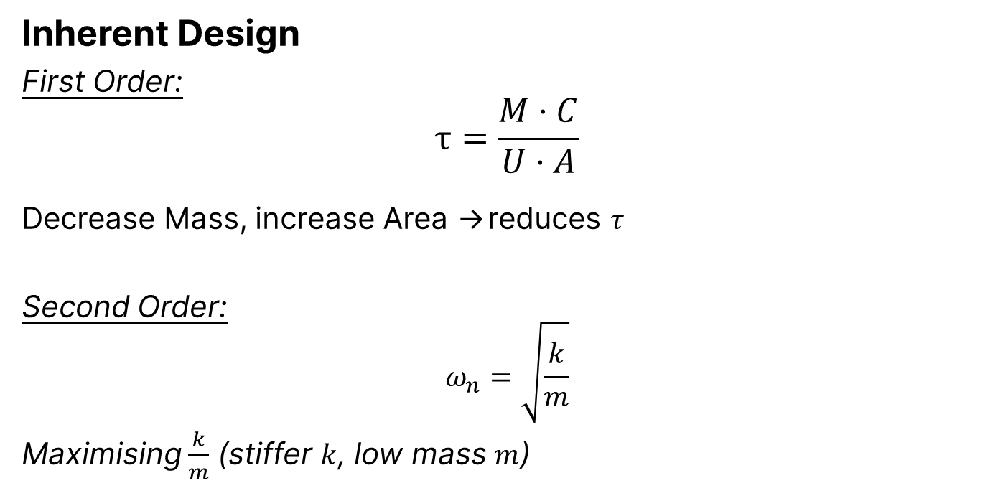
Dynamics Compensations
Inherent Design
First Order:
$$τ=\frac{M⋅C}{U⋅A}$$
Decrease Mass, increase Area →reduces $τ$
Second Order:
$$ω_{n}=\sqrt{\frac{k}{m}}$$
Maximising $\frac{k}{m}$ (stiffer $k$, low mass $m$)

Slide 16
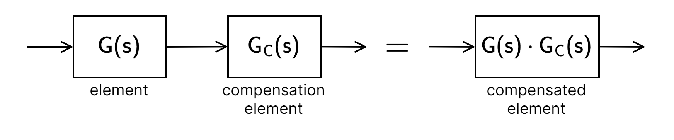

Dynamics Compensations
Open Loop Compensation
$$\frac{1}{1+τ⋅s}⋅\frac{1+τ⋅s}{1+τ_{2}⋅s}=\frac{1}{1+τ_{2}⋅s}$$

Slide 17
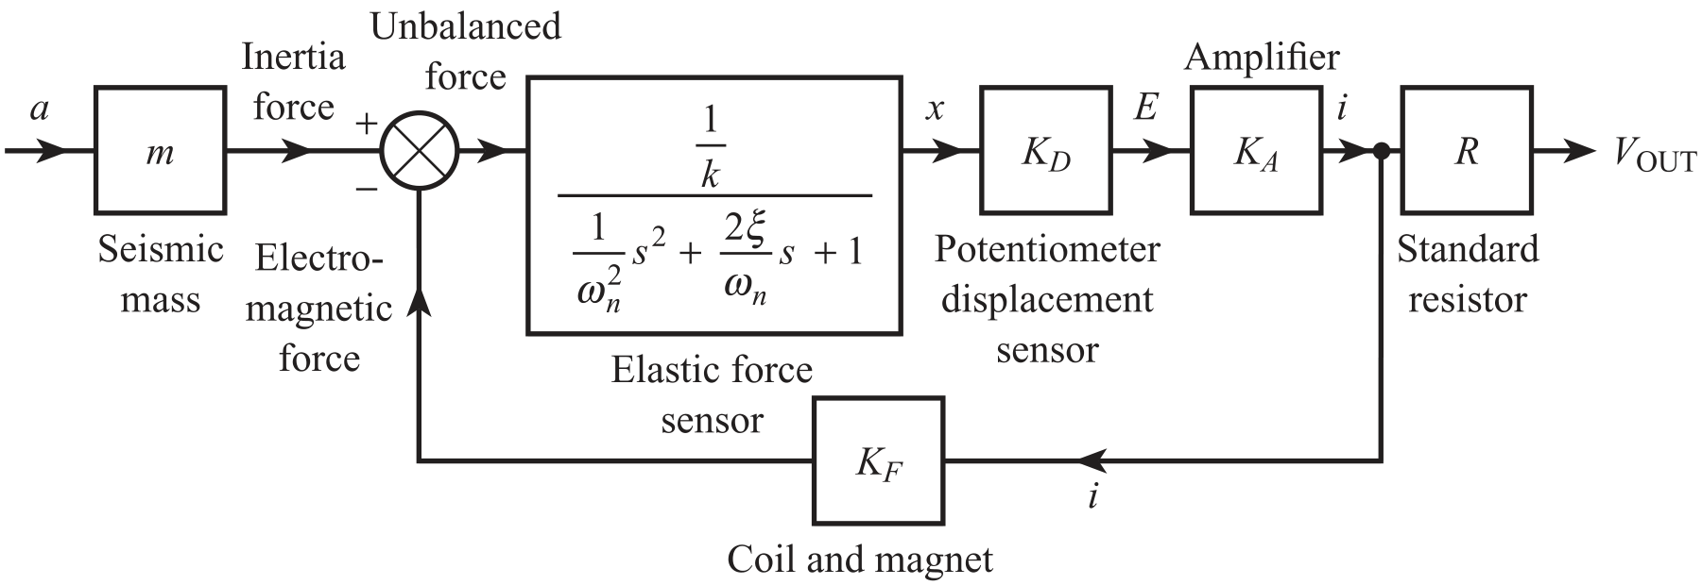

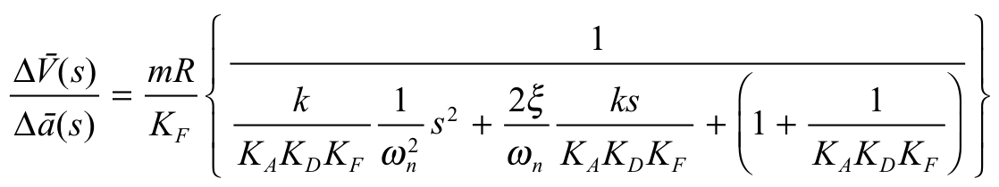
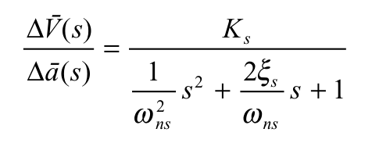
Dynamics Compensations
Closed Loop Compensation (High Gain)

